Slide 1
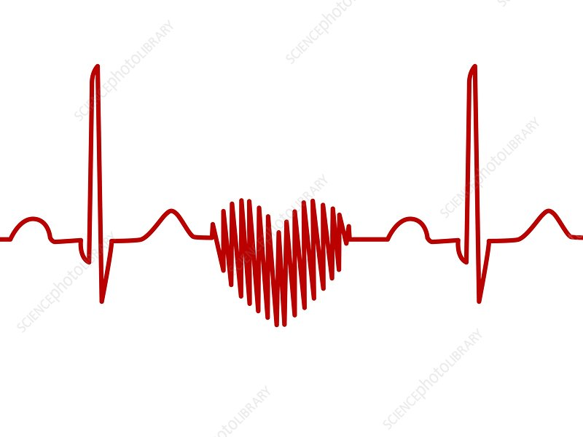
CARDIAC DYSRHYTHMIAS
PREPARED AND COLLATED BY:
FRANKLIN S. CASISON, RN, MAN, MD

Slide 2
Cardiac dysrhythmias
Abnormal heart rhythms caused by changes in electrical impulses that coordinate heartbeats.
Also known as arrhythmias

Slide 3
🔹 Types
Tachycardia
Bradycardia
Atrial Fibrillation – Irregular, often rapid atrial rhythm
Ventricular Fibrillation – Disorganized ventricular rhythm, life-threatening
Premature Beats – Early heartbeats from atria or ventricles

Slide 4
🔹 Causes
Coronary artery disease
Electrolyte imbalance
Heart injury or surgery
Medications or stimulants
Stress, alcohol, smoking

Slide 5
🔹 Symptoms
Palpitations
Dizziness or fainting
Chest pain
Shortness of breath
Fatigue

Slide 6
🔹Management
Medications (antiarrhythmics, beta- blockers)
Electrical therapy (cardioversion, pacemaker, defibrillator)
Lifestyle modifications
Ablation therapy

Slide 7
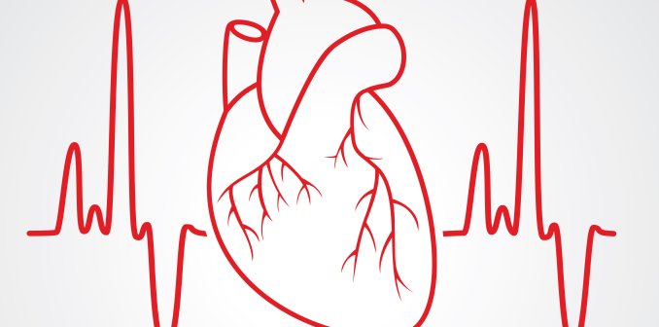
electrocardiogram

Slide 8
Electrocardiogram
A test that records the electrical activity of the heart to assess rhythm, rate, and cardiac health.
Key Components
P Wave – Atrial depolarization
QRS Complex – Ventricular depolarization
T Wave – Ventricular repolarization
PR Interval – Time from atrial to ventricular activation
ST Segment – Time between depolarization and repolarization

Slide 9
🔹 Indications
Chest pain or palpitations
Suspected arrhythmias
Monitoring after MI or surgery
Pre-operative screening

Slide 10
🔹Interpretation
Rate – Normal: 60–100 bpm
Rhythm – Regular or irregular
Axis – Direction of electrical activity
Wave abnormalities – May indicate ischemia, infarction, hypertrophy, or electrolyte imbalance

Slide 11
🔹🫀 Types of Cardiac Dysrhythmias
1. Sinus Dysrhythmias
Sinus Tachycardia – HR > 100 bpm
Sinus Bradycardia – HR < 60 bpm
Sinus Arrhythmia – Irregular rhythm, often related to breathing

Slide 12
🔹🫀 Types of Cardiac Dysrhythmias
2. Atrial Dysrhythmias
Atrial Fibrillation (AFib) – Irregular, chaotic atrial activity
Atrial Flutter – Rapid, regular atrial rhythm (sawtooth waves)
Supraventricular Tachycardia (SVT) – Fast rhythm from above the ventricles
Premature Atrial Contractions (PACs) – Early atrial beats

Slide 13
🔹🫀 Types of Cardiac Dysrhythmias
3. Junctional Dysrhythmias
Junctional Rhythm – Impulse originates near AV node
Accelerated Junctional Rhythm – Faster rate than normal junctional rhythm
Premature Junctional Complexes (PJCs) – Early beats from AV junction

Slide 14
🔹🫀 Types of Cardiac Dysrhythmias
4. Ventricular Dysrhythmias
Premature Ventricular Contractions (PVCs) – Early ventricular beats
Ventricular Tachycardia (VTach) – Fast, wide QRS complex rhythm
Ventricular Fibrillation (VFib) – Chaotic, uncoordinated electrical activity
Torsades de Pointes – Polymorphic VT, often drug-induced

Slide 15
🔹🫀 Types of Cardiac Dysrhythmias
5. Heart Blocks (AV Blocks)
First-Degree Block – Prolonged PR interval
Second-Degree Block
Type I (Wenckebach) – Progressive PR lengthening
Type II – Intermittent dropped beats
Third-Degree Block (Complete Block) – No atrial-ventricular conduction

Slide 16
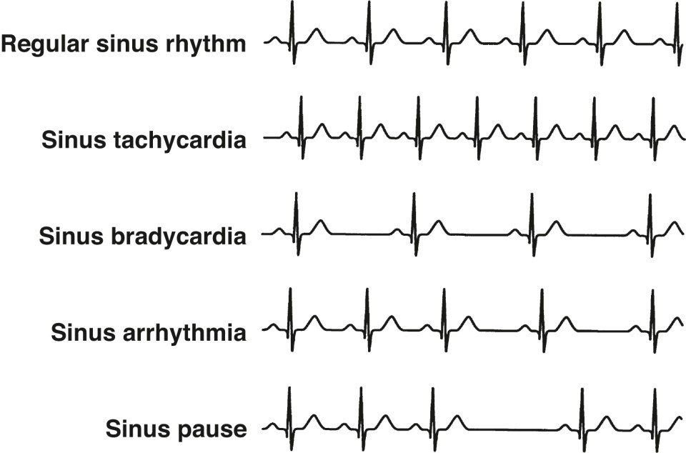
Sinus Dysrhythmias

Slide 17
🫀 Sinus Tachycardia – HR > 100 bpm
- A normal rhythm originating from the sinoatrial (SA) node with a heart rate >100 bpm (in adults).
- ECG Characteristics
Regular rhythm
HR: 100–150 bpm
Normal P waves before every QRS
PR interval and QRS duration: Normal

Slide 18
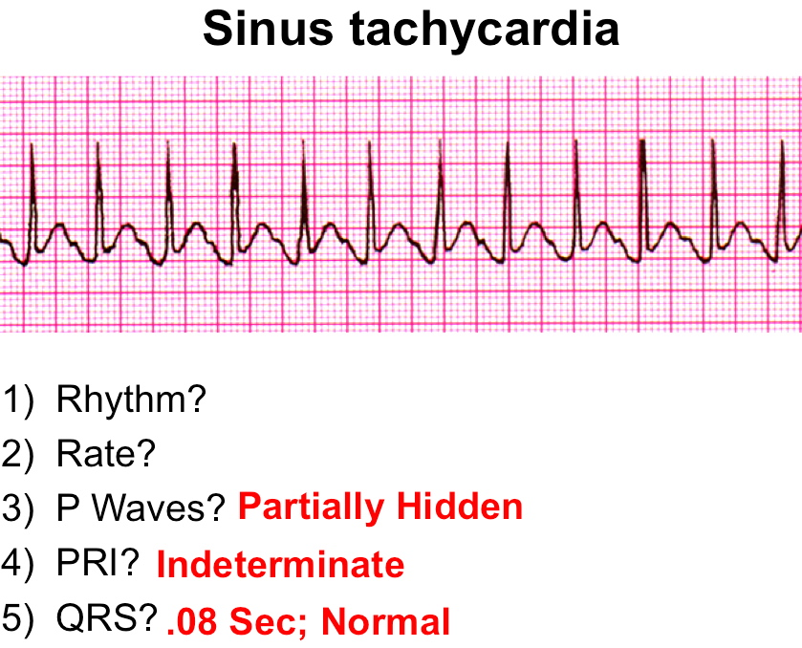

Slide 19
🔹 Causes
Fever
Pain
Anxiety/stress
Exercise
Hypovolemia
Anemia
Hyperthyroidism
Stimulants (e.g., caffeine, nicotine)

Slide 20
🔹Symptoms
Palpitations
Dizziness
Shortness of breath
May be asymptomatic
🔹 Management
Treat underlying cause (e.g., fluids, pain relief)
Beta-blockers or calcium channel blockers in symptomatic patients
Monitor vitals and ECG

Slide 21
🫀 Sinus Bradycardia – HR < 60 bpm
- A normal rhythm from the sinoatrial (SA) node with a heart rate <60 bpm in adults.
🔹 ECG Characteristics
Regular rhythm
HR: <60 bpm
Normal P waves before each QRS
PR interval and QRS duration: Normal

Slide 22
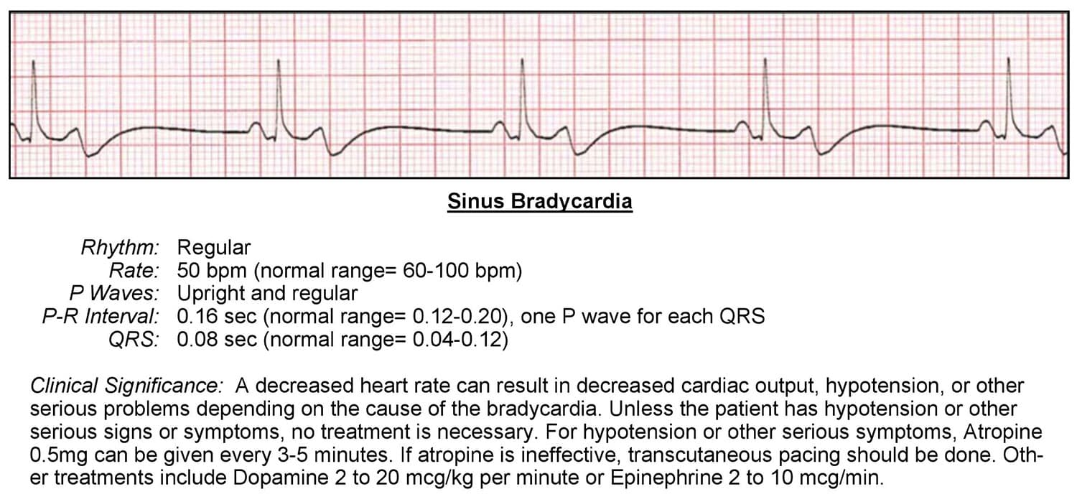

Slide 23
🔹 Causes
Normal in athletes or during sleep
Hypothyroidism
Hypothermia
Increased vagal tone
Medications (e.g., beta-blockers, digoxin)
Myocardial infarction (especially inferior wall)

Slide 24
🔹Symptoms
Often asymptomatic
Dizziness
Fatigue
Syncope (fainting)
Hypotension

Slide 25
🔹Management
Asymptomatic: Observe
Symptomatic:
Atropine IV
Pacemaker if persistent
Stop or adjust causative medications

Slide 26
🫀 Sinus Arrhythmia
- often called Sinus Respiratory Arrhythmia
- A normal irregularity in heart rhythm originating from the SA node, often related to the respiratory cycle.

Slide 27
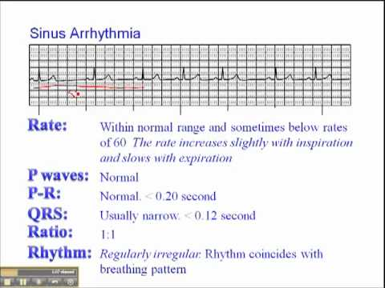

Slide 28
🔹 ECG Characteristics
Irregular rhythm
HR: Typically 60–100 bpm
P waves: Normal, consistent shape
Variation in RR intervals (shorter during inspiration, longer during expiration)
PR interval and QRS: Normal

Slide 29
🔹 Causes
Common in children and young adults
Influenced by vagal tone
Seen during normal breathing
Can also occur with medications or increased intracranial pressure
🔹 Symptoms
Usually asymptomatic
Detected incidentally on ECG

Slide 30
🔹Management
No treatment needed
Reassure patient – considered benign
Rule out pathological causes if symptoms are present

Slide 31
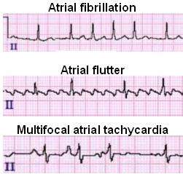
Atrial Dysrhythmias

Slide 32
🫀 atrial Fibrillation (AFib)
- A common supraventricular arrhythmia characterized by disorganized atrial electrical activity, leading to an irregularly irregular rhythm.
- Irregular, chaotic atrial activity

Slide 33
🔹ECG Characteristics
No distinct P waves
Irregularly irregular RR intervals
Narrow QRS complexes
Variable ventricular rate

Slide 34
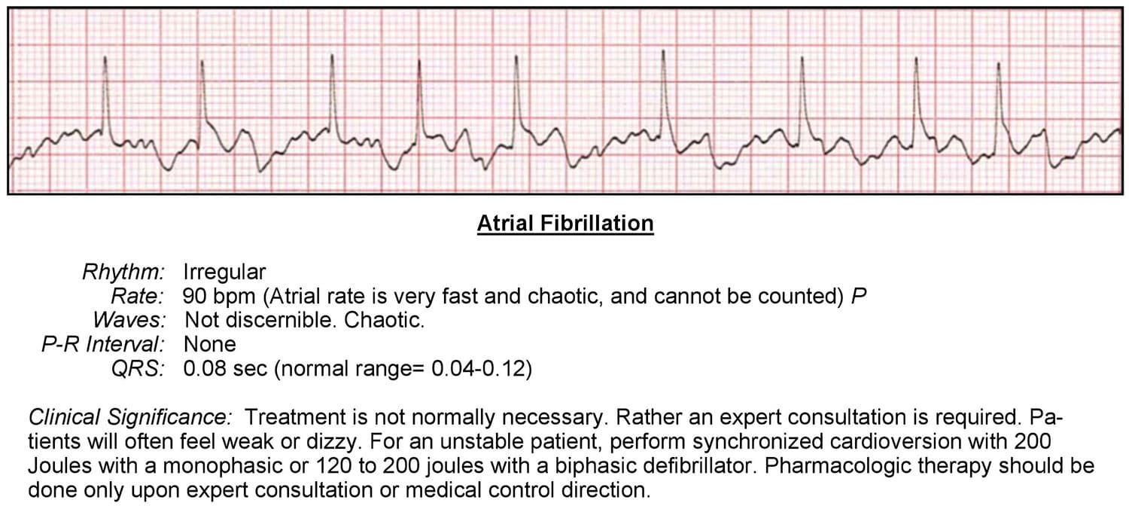

Slide 35
🔹Causes
Hypertension
Coronary artery disease
Heart failure
Valvular disease
Hyperthyroidism
Alcohol ("holiday heart")

Slide 36
🔹Symptoms
Palpitations
Fatigue
Dizziness
Dyspnea
May be asymptomatic

Slide 37
🔹Management
Rate control: Beta-blockers, calcium channel blockers
Rhythm control: Antiarrhythmics, cardioversion
Anticoagulation: To reduce stroke risk (based on CHA₂DS₂-VASc score)
Ablation: In selected patients

Slide 38
🫀 Atrial Flutter
- A type of supraventricular tachycardia caused by a reentrant circuit in the atria, leading to a rapid, regular atrial rate (usually ~250–350 bpm).
- Rapid, regular atrial rhythm (sawtooth waves)

Slide 39
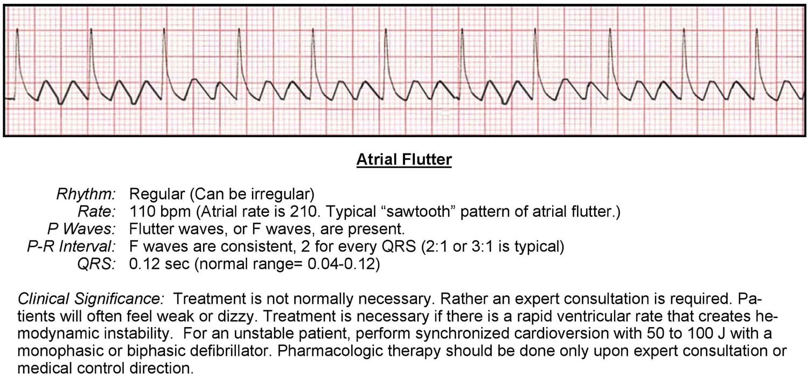

Slide 40
🔹 Causes
Heart failure
Valvular heart disease
Post-cardiac surgery
COPD
Alcohol use

Slide 41
🔹 Symptoms
Palpitations
Fatigue
Lightheadedness
Dyspnea
May be asymptomatic

Slide 42
🔹 ECG Characteristics
"Sawtooth" flutter waves (especially in leads II, III, aVF)
Regular atrial activity
Ventricular rate often regular (e.g., 2:1, 3:1 conduction)
Narrow QRS unless preexisting block

Slide 43
🔹 Management
Rate control: Beta-blockers or calcium channel blockers
Rhythm control: Cardioversion or antiarrhythmics
Anticoagulation: To prevent thromboembolism
Catheter ablation: Often curative

Slide 44
🫀 Supraventricular Tachycardia (SVT)
- A rapid heart rhythm originating above the ventricles, usually with a narrow QRS complex and a regular rhythm.
- Fast rhythm from above the ventricles

Slide 45
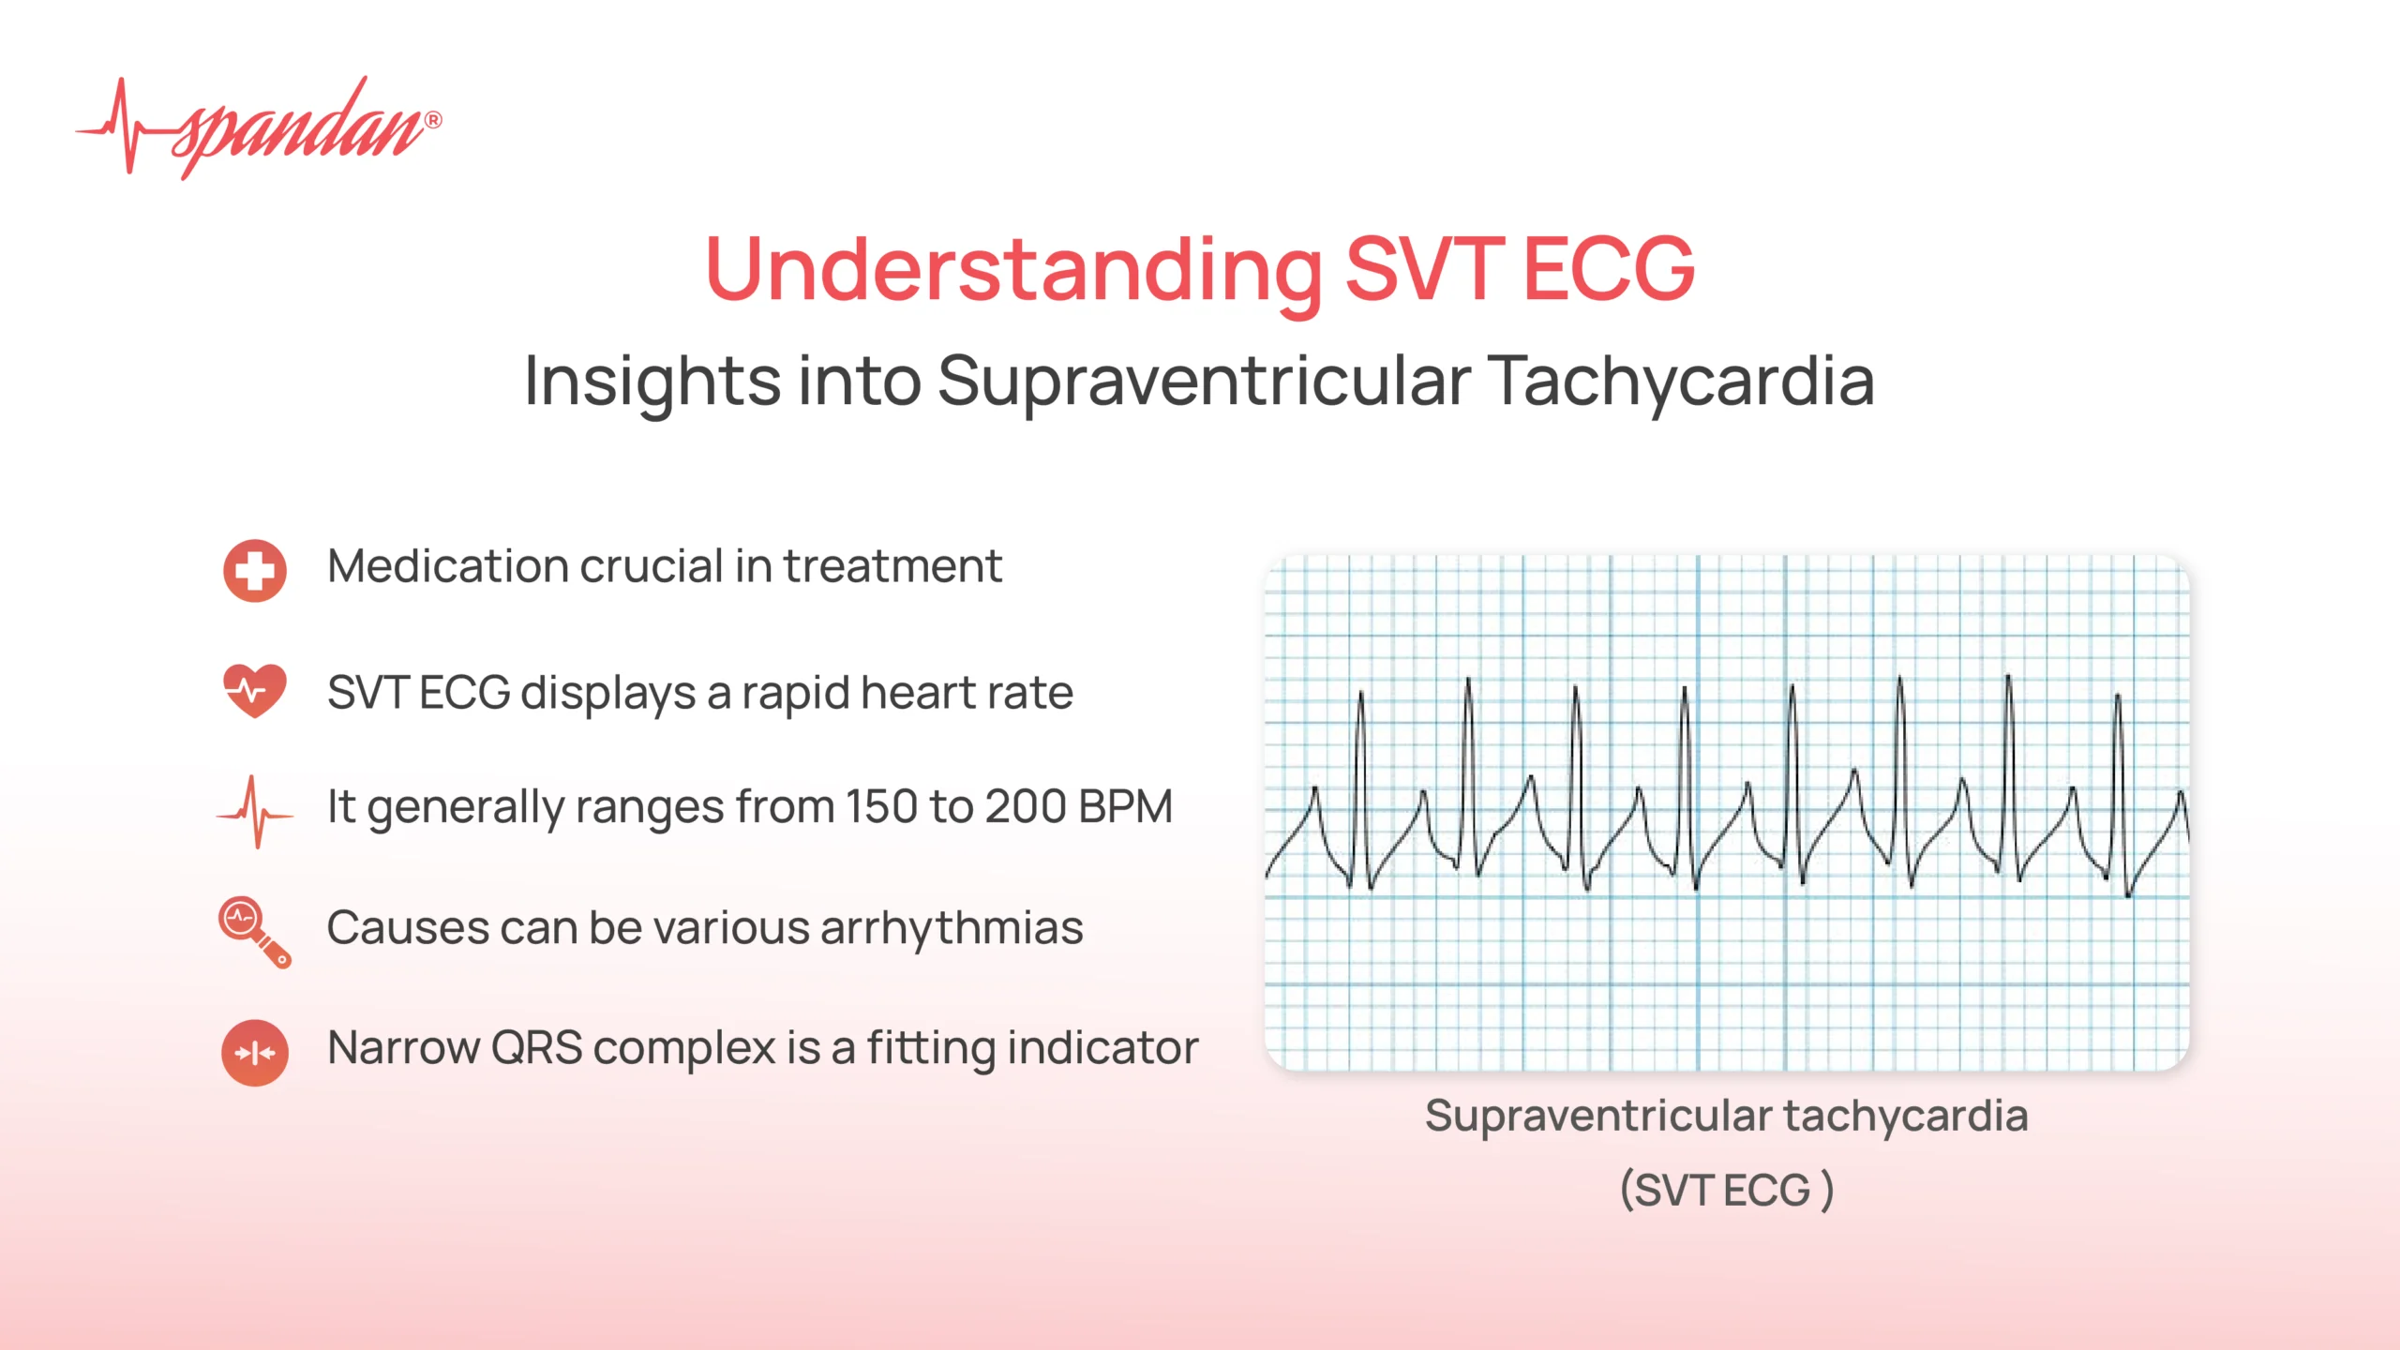

Slide 46
🔹 ECG Characteristics
Regular rhythm
HR: 150–250 bpm
Narrow QRS complexes
P waves may be hidden or inverted (retrograde)
Sudden onset and termination

Slide 47
🔹 Causes
Stress or anxiety
Caffeine or stimulants
Hyperthyroidism
Structural heart disease
WPW syndrome (in AVRT type)

Slide 48
🔹 Symptoms
Palpitations
Dizziness
Chest discomfort
Shortness of breath
Syncope (in severe cases)

Slide 49
🔹 Management
Vagal maneuvers (e.g., Valsalva)
Adenosine IV (first-line drug)
Beta-blockers / calcium channel blockers
Catheter ablation for recurrent SVT

Slide 50
🫀 Premature Atrial Contractions (PACs)
- Early atrial beats
- Early atrial beats that originate outside the SA node, interrupting the normal rhythm temporarily.

Slide 51
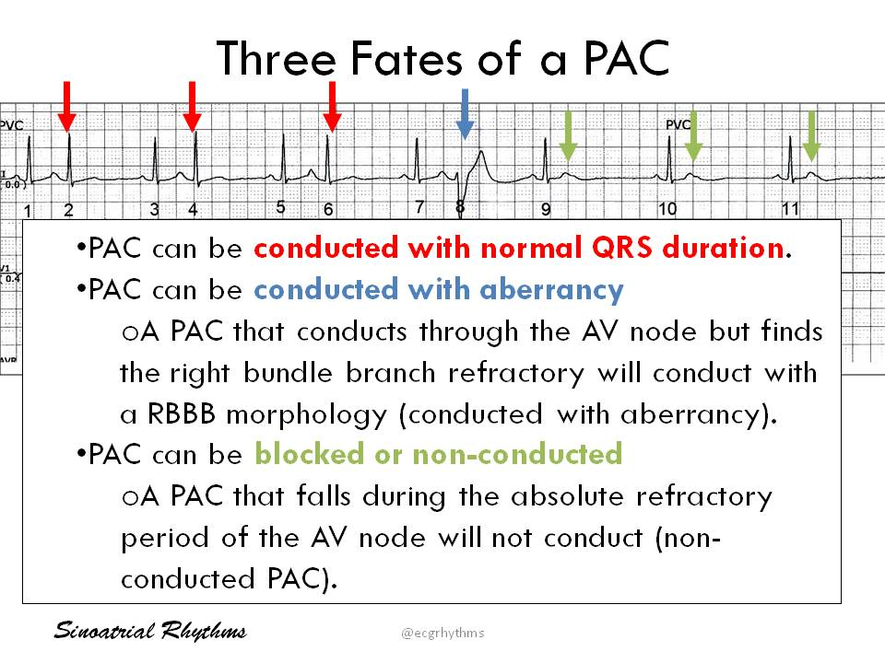

Slide 52
🔹 ECG Characteristics
Early P wave (often abnormal shape)
Normal QRS complex follows
Compensatory pause may occur
Rhythm: Irregular due to premature beat

Slide 53
🔹 Causes
Stress, anxiety
Caffeine, alcohol, nicotine
Electrolyte imbalance
Hypoxia
Myocardial ischemia
Seen in healthy individuals too

Slide 54
🔹 Symptoms
Often asymptomatic
May feel like palpitations or "skipped beats"
🔹 Management
Usually no treatment needed
Address triggers (e.g., reduce caffeine/stress)
Beta-blockers if symptomatic or frequent
Investigate if structural heart disease is suspected

Slide 55
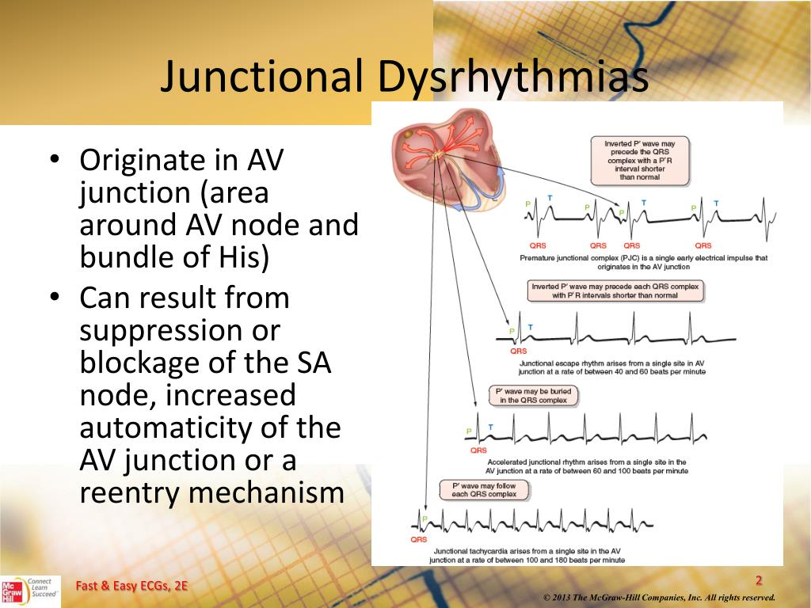
JUNCTIONAL DYSRHYTHMIAS

Slide 56
🫀 Junctional Rhythm
- A rhythm originating from the atrioventricular (AV) junction when the SA node fails or conduction is blocked.
🔹 ECG Characteristics
Heart rate: 40–60 bpm (intrinsic AV node rate)
Regular rhythm
P waves: Absent, inverted, or occur after QRS
QRS complex: Normal width
PR interval: Absent or shortened if visible

Slide 57
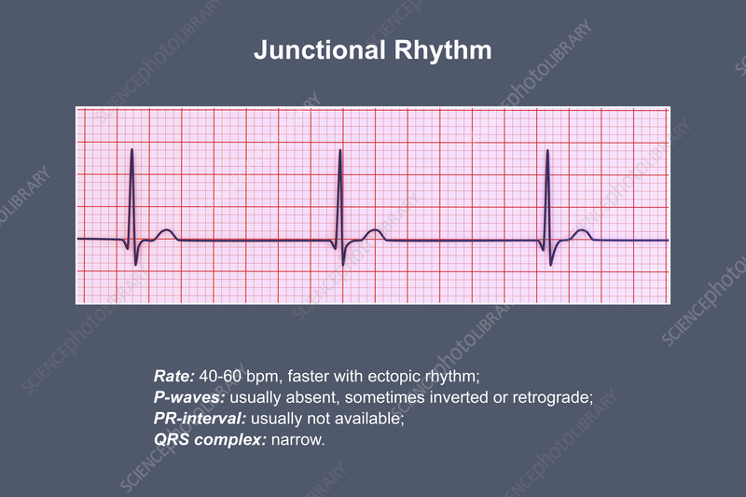
🔹Junctional Rhythm

Slide 58
🔹 Causes
SA node dysfunction
Myocardial infarction (especially inferior)
Digitalis toxicity
Post-cardiac surgery
Electrolyte disturbances

Slide 59
🔹 Symptoms
Often asymptomatic if rate adequate
May experience dizziness, fatigue, or hypotension if bradycardic
🔹 Management
Asymptomatic: Monitor
Symptomatic:
Atropine
Temporary pacing
Treat underlying cause (e.g., medication adjustment)

Slide 60
🫀 Accelerated Junctional Rhythm
- Faster rate than normal junctional rhythm
- A rhythm originating from the AV junction with a rate faster than the intrinsicj Junctional rate (60–100 bpm)
- but slower than junctional tachycardia.

Slide 61
🔹 ECG Characteristics
Rate: 60–100 bpm
Rhythm: Regular
P waves: Absent, inverted, or after QRS
QRS: Normal width
May resemble normal sinus rhythm but with abnormal P wave placement

Slide 62
🔹 Causes
Digitalis toxicity
Myocardial infarction (especially inferior)
Post-cardiac surgery
Electrolyte imbalance
Normal variant in children or athletes

Slide 63
🔹 Symptoms
Often asymptomatic
May cause palpitations, dizziness, or fatigue
🔹 Management
Treat underlying cause (e.g., stop digoxin)
Monitor if stable
Rarely needs specific treatment unless hemodynamically unstable

Slide 64
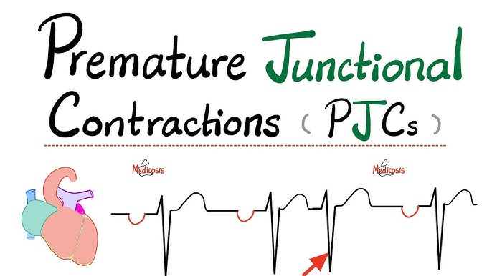
🫀 Premature Junctional Complexes (PJCs)
- Early beats from AV junction
- occurring before the next expected sinus beat.

Slide 65
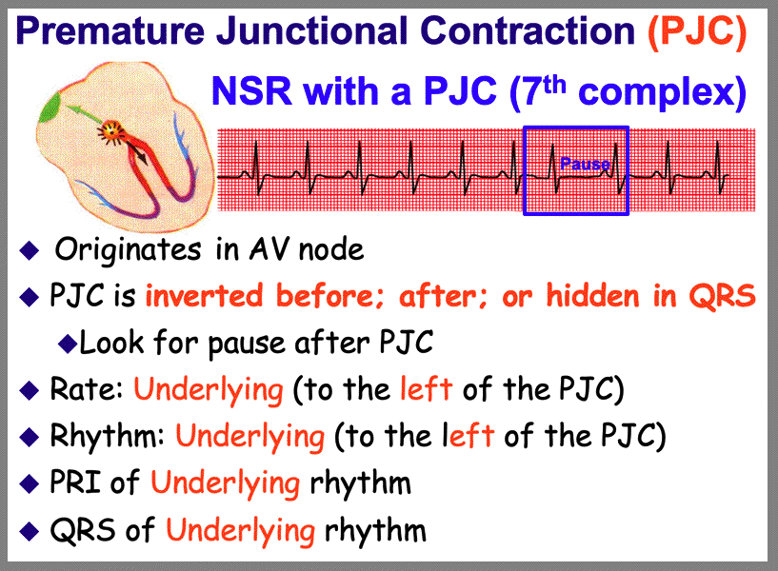

Slide 66
🫀 Premature Junctional Complexes (PJCs)
- Early beats from AV junction
- occurring before the next expected sinus beat.
🔹 ECG Characteristics
Early, narrow QRS complex
P wave: Absent, inverted, or occurs after QRS
Compensatory pause may follow
Rhythm: Irregular due to premature beat

Slide 67
🔹 Causes
Digitalis toxicity
Stimulants (caffeine, nicotine)
Hypoxia
Electrolyte imbalance
Myocardial ischemia or infarction

Slide 68
🔹 Symptoms
Usually asymptomatic
May feel like a palpitation or "skipped beat"
🔹 Management
No treatment if infrequent and asymptomatic
Treat underlying cause
Reduce triggers (e.g., caffeine, drugs)
Monitor for progression to junctional rhythm

Slide 69
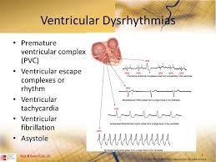
🫀 Ventricular
Dysrhythmias
- some ventricular dysrhythmias are indeed life-threatening. They can disrupt the heart's ability to pump blood effectively, leading to serious complications like cardiac arrest or sudden cardiac death.

Slide 70
🫀 Premature Ventricular Contractions (PVCs)
- Early ventricular beats
- early beat arising in the ventricles (Purkinje fibers) instead of SA node
- Common in healthy individuals; prevalence increases with age and among males
- Palpitations, “skipped beat,” thumping in chest or neck
- Often benign = most individuals with isolated PVCs do well

Slide 71
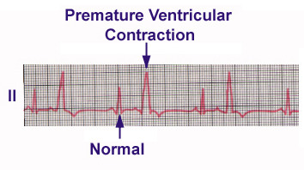
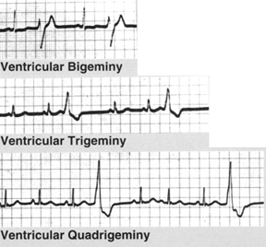
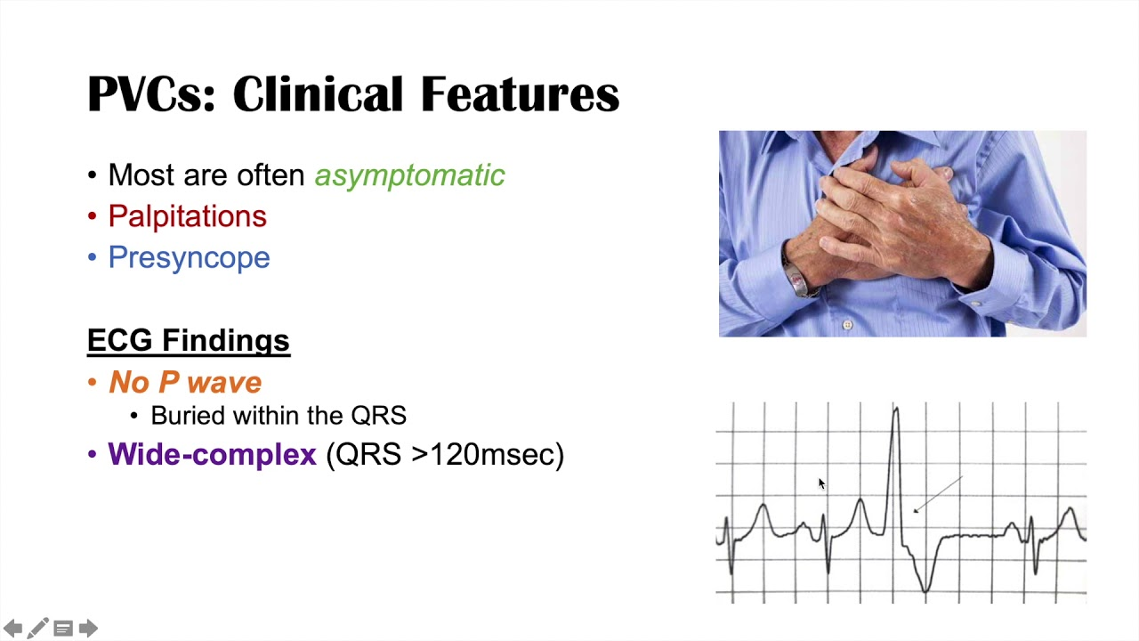

Slide 72
🔹VC Patterns
Unifocal (monomorphic): identical morphology, single focus
Multifocal (multiform): varying morphology/timing, multiple origins
Common rhythm patterns:
Bigeminy (PVC every alternate beat)
Trigeminy/Quadrigeminy, Couplets, Triplets/NSVT (≥ 3 consecutive PVCs = non‑sustained VT)
Provoking factors: caffeine, alcohol, nicotine/stimulants, stress/anxiety, electrolyte imbalance (K⁺, Mg²⁺)

Slide 73
🔹Management
Without structural heart disease:
Reassurance, lifestyle modification (avoid triggers), correct electrolytes, treat anxiety
Beta-blockers first-line if symptomatic; calcium-channel blockers can be considered if β-blockers contraindicated
Class I/III antiarrhythmics (e.g. flecainide, amiodarone) reserved for refractory cases; avoid Ic in CAD

Slide 74
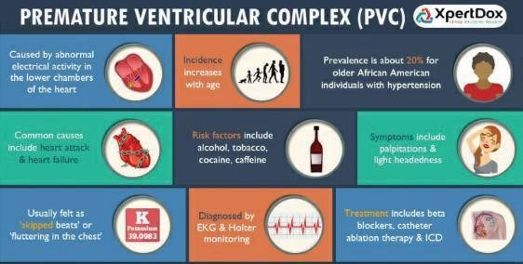

Slide 75
🫀 Ventricular Tachycardia (VTach)
Summary Table
Parameter Ventricular Tachycardia (VT)
PR interval Absent or variable due to atrioventricular dissociation
QRS duration ≥ 120 ms (often ≥ 140–160 ms), abnormal morphology
Rhythm Usually regular; ventricular rate 120–250 bpm (commonly 150–200)
A‑V ratio No fixed ratio; atrial and
ventricular activity operate independently-

Slide 76
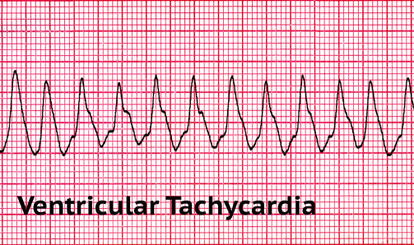
🫀 Ventricular Tachycardia (VTach)

Slide 77
🫀 Ventricular Tachycardia (VTach)
Any wide‑complex tachycardia should be treated as VT until proven otherwise.
If uncertain, assume VT and proceed with advanced cardiac life support (ACLS) protocols (cardioversion, antiarrhythmics) rather than risk deterioration.
Though PR interval, QRS morphology, rhythm regularity, and capture/fusion beats are central to diagnosis, interpreting them requires clear ECG tracings, often orthogonal chest leads and sometimes expert input.

Slide 78
🫀 Ventricular Fibrillation (VFib)
- Chaotic, uncoordinated electrical activity
- Sudden cardiac electrical chaos and pulseless arrest

Slide 79
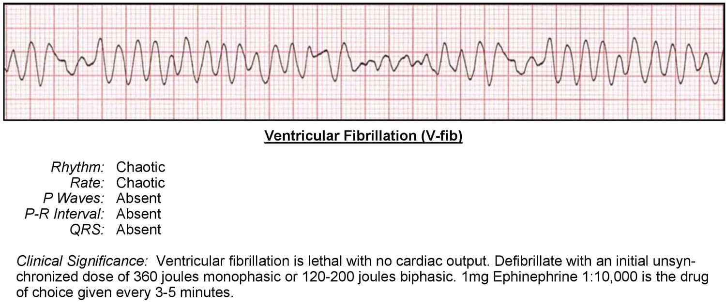
🫀 Ventricular Fibrillation (VFib)

Slide 80
🔹 Clinical & ECG Features
- Presents suddenly with collapse, loss of pulse, apnea or gasping, and no discernible blood pressure
- ECG shows irregular, fibrillatory waves with no organized QRS complexes NO P waves; ventricular rate of 300–400 bpm (200 - 250 bpm)

Slide 81
🔹 NURSING ManAGEMENT
- Ensure Code/Crash Cart and AED/monitor with defibrillator always accessible at the bedside; pads already connected or quickly positioned
- Verify staff competency: ACLS-certified team members, regular simulation drills (code team, defibrillation, CPR timing)
- Review patient risk factors: old MI, ischemia, electrolytes (K⁺, Mg²⁺), digitalis toxicity, acute MI or heart failure

Slide 82
🔹 NURSING ManAGEMENT
- Initial Recognition & Response Rapid assessment: Unresponsive + apnea + absent carotid/femoral pulse = assume VF or pulseless VT
- Activate emergency response immediately (call code, alert ICU, assign runner for cart); avoid leaving patient unattended
- Begin immediate CPR—chest compressions at 100‑120/min, depth 5–6 cm, full recoil, minimal interruptions; ratio 30:2

Slide 83
🔹 NURSING ManAGEMENT
- High‑Quality CPR & Defibrillation
- Perform high‑quality CPR while AED/defibrillator is charged
- First shock (biphasic 120‑200 J; monophasic 360 J) as soon as available; resume CPR immediately after shock, regardles of rhythm result
- Continue shocks every 2 minutes of CPR until return of spontaneous circulation (ROSC)

Slide 84
🔹 NURSING ManAGEMENT
- Medications & Advanced Airway:
a. iV/IO access placement early; draw labs (ABG, electrolytes, troponin, coagulation)
b. Epinephrine 1 mg IV/IO every 3–5 minutes after second shock
c. Amiodarone 300 mg IV/IO if VF persists after multiple shocks; repeat 150 mg if needed
d. Lidocaine 1–1.5 mg/kg if amiodarone is unavailable or contraindicated
e. Establish advanced airway without prolonged pauses; ventilate at 10 breaths/min once intubated; capnography for ETCO₂ monitoring

Slide 85
🔹 NURSING ManAGEMENT
- Medications & Advanced Airway:
a. iV/IO access placement early; draw labs (ABG, electrolytes, troponin, coagulation)
b. Epinephrine 1 mg IV/IO every 3–5 minutes after second shock
c. Amiodarone 300 mg IV/IO if VF persists after multiple shocks; repeat 150 mg if needed
d. Lidocaine 1–1.5 mg/kg if amiodarone is unavailable or contraindicated
e. Establish advanced airway without prolonged pauses; ventilate at 10 breaths/min once intubated; capnography for ETCO₂ monitoring

Slide 86
🔹 NURSING ManAGEMENT
Post‑Resuscitation Care (Post‑ROSC)
Transfer to ICU if not already there; continuous ECG, SpO₂, invasive BP, neurovitals monitoring
Monitor ABGs, electrolytes, correct abnormalities (K⁺, Mg²⁺, Ca²⁺)
Consider therapeutic hypothermia if indicated (e.g. comatose after ROSC)
Ensure hemodynamic support (vasopressors, fluid), review for urgent PCI if MI suspected

Slide 87
🔹 NURSING ManAGEMENT
Documentation: exact time of arrest, CPR start, defibrillation attempts, medication doses, patient responses
Notify family; explain condition, provide updates, remain visible during code
Supportive care post‑event: keep patient warm, minimize environmental stimuli, prevent sensory overload—especially in ICU survivors
Nursing Exercise
Plan discharge teaching and risk reduction (ICD education, warning signs, lifestyle modifications, CPR training for family)

Slide 88
🫀 Torsades de Pointes
- Polymorphic VT, often drug-induced
- Polymorphic VT showing twisting QRS around baseline (“party streamer” pattern) associated with QTc prolongation
- Often initiated by a PVC landing on T‑wave (“R‑on‑T” phenomenon)
- Classic pause‑dependent sequence (short‑long‑short RR) occurs in most acquired forms

Slide 89
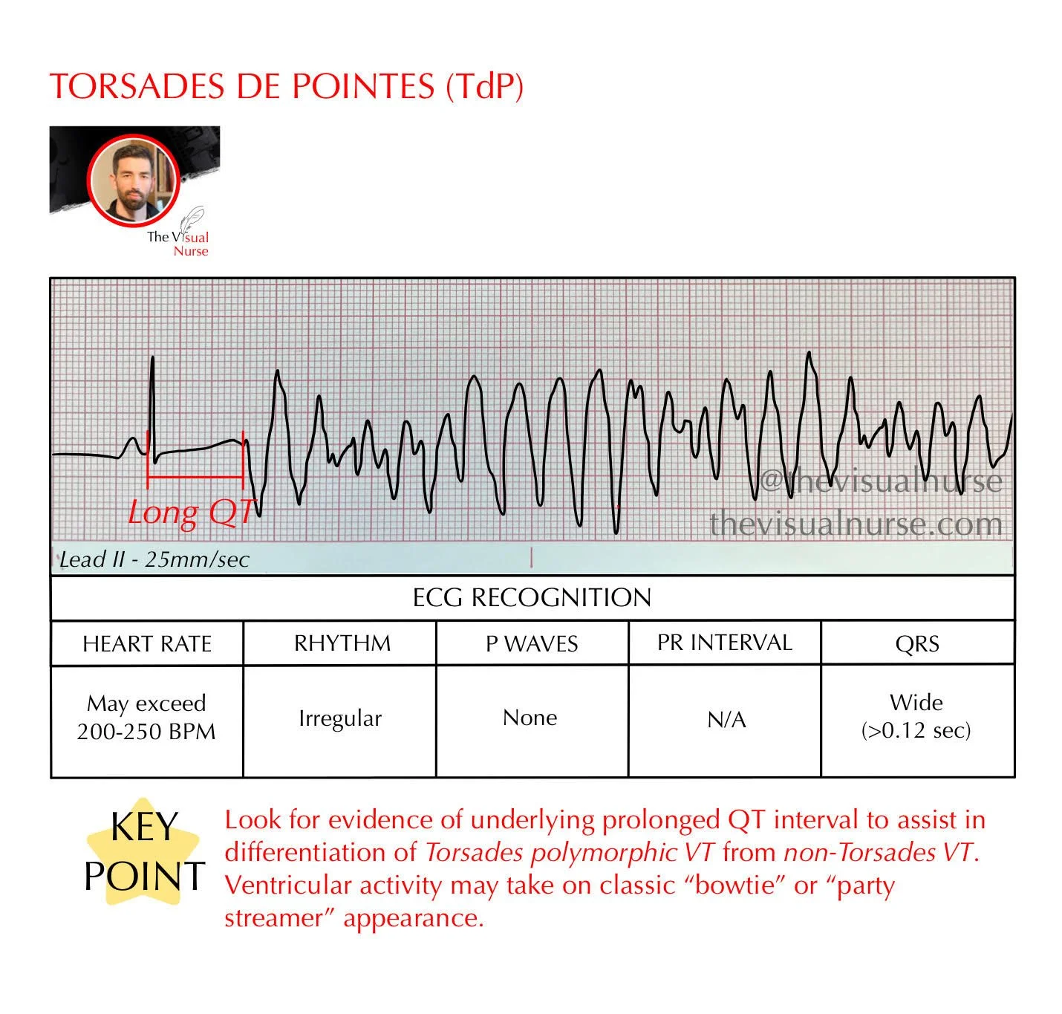
🫀 Torsades de Pointes

Slide 90
🫀 Torsades de Pointes
🔹A distinct form of polymorphic ventricular tachycardia, characterized by QRS complexes that appear to twist around the ECG baseline, typically occurring against a prolonged QT interval (QTc > 500 ms)
- May be congenital (genetic long QT syndromes) or acquired, most often due to QT-prolonging medications (e.g. sotalol, quinidine, antipsychotics, macrolides, methadone) or electrolyte disturbances (especially ↓K⁺, ↓Mg²⁺, ↓Ca²⁺); bradycardia, hypothermia, and structural heart disease also contribute

Slide 91
🫀 Torsades de Pointes
🔹ECG classically shows a short–long–short RR sequence, often triggered by an R‑on‑T PVC, followed by waxing‑and‑waning QRS amplitude (“twisting”)
Presents with palpitations, lightheadedness, syncope; VT bursts may be self-terminating, but high risk of degeneration into ventricular fibrillation and sudden cardiac death

Slide 92
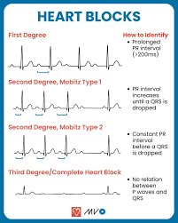
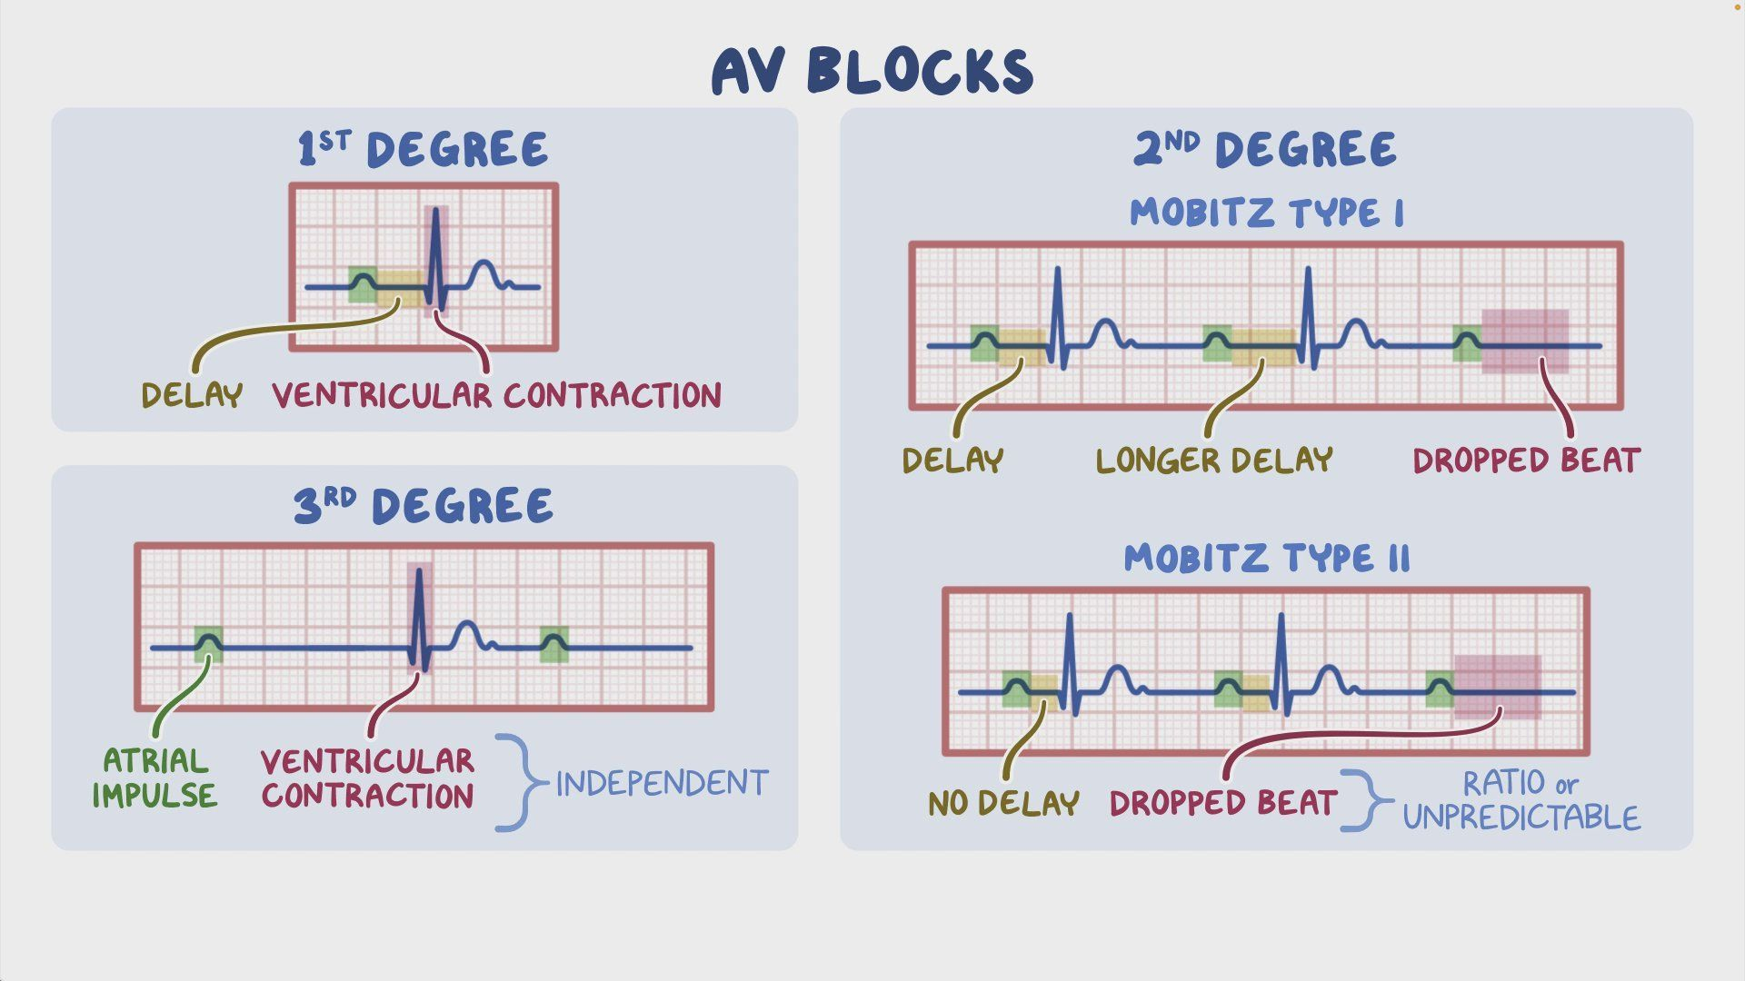
Heart blocks

Slide 93
🫀 First degree Heart Block
🔹just a slowed conduction—prolonged PR interval
- a heart condition where the electrical signal traveling from the atria to the ventricles is delayed
- but not completely blocked
- delay = is prolonged PR interval (longer than 0.20 sec.
- mild condition, often asymptomatic, and usually doesn’t
require treatment.

Slide 94
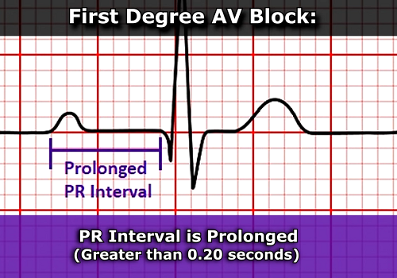

Slide 95
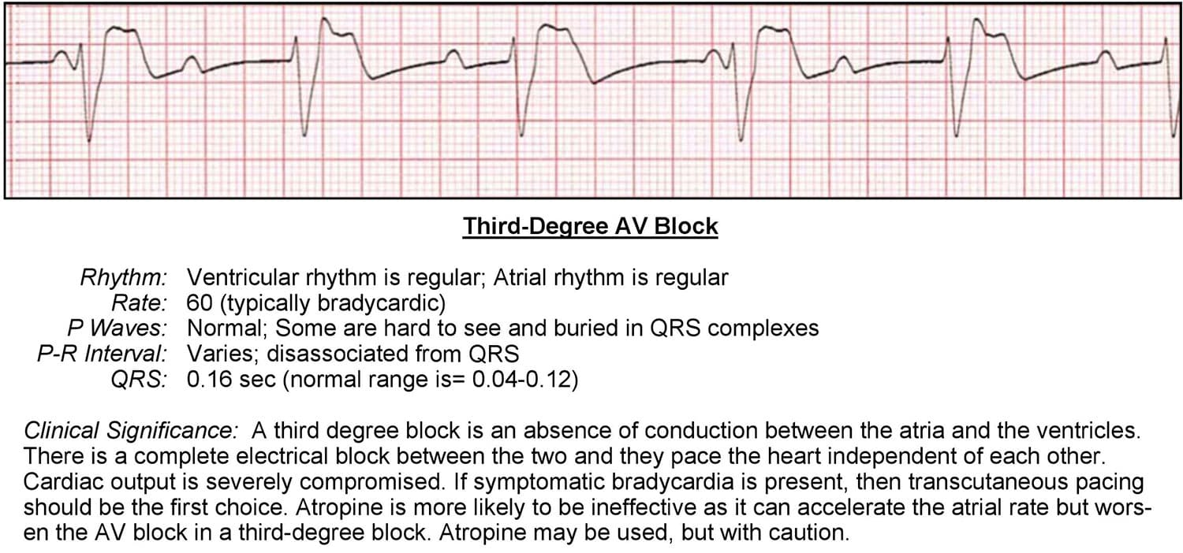

Slide 96
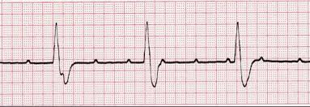

Slide 97
🫀 Third-degree atrioventricular (AV) block
🔹also known as complete heart block,
- is a serious heart rhythm disorder where no atrial impulses reach the ventricles.
- means the atria and ventricles beat independently of each other, often at slower and potentially unstable rates.
🔹 Complete AV Dissociation
Notes:
Dissociation - independently

Slide 98
🫀 Second-degree HEART block
🔹 also known as "incomplete" heart block because it's not a complete block, but rather a partial one.
- a heart condition where some atrial impulses fail to reach the ventricles.
Notes:
- some impulses are blocked (INCOMPLETE)
- electrical signals from the atria (upper heart chambers) don't always make it through to the ventricles (lower heart chambers), disrupting the normal heart rhythm.

Slide 99
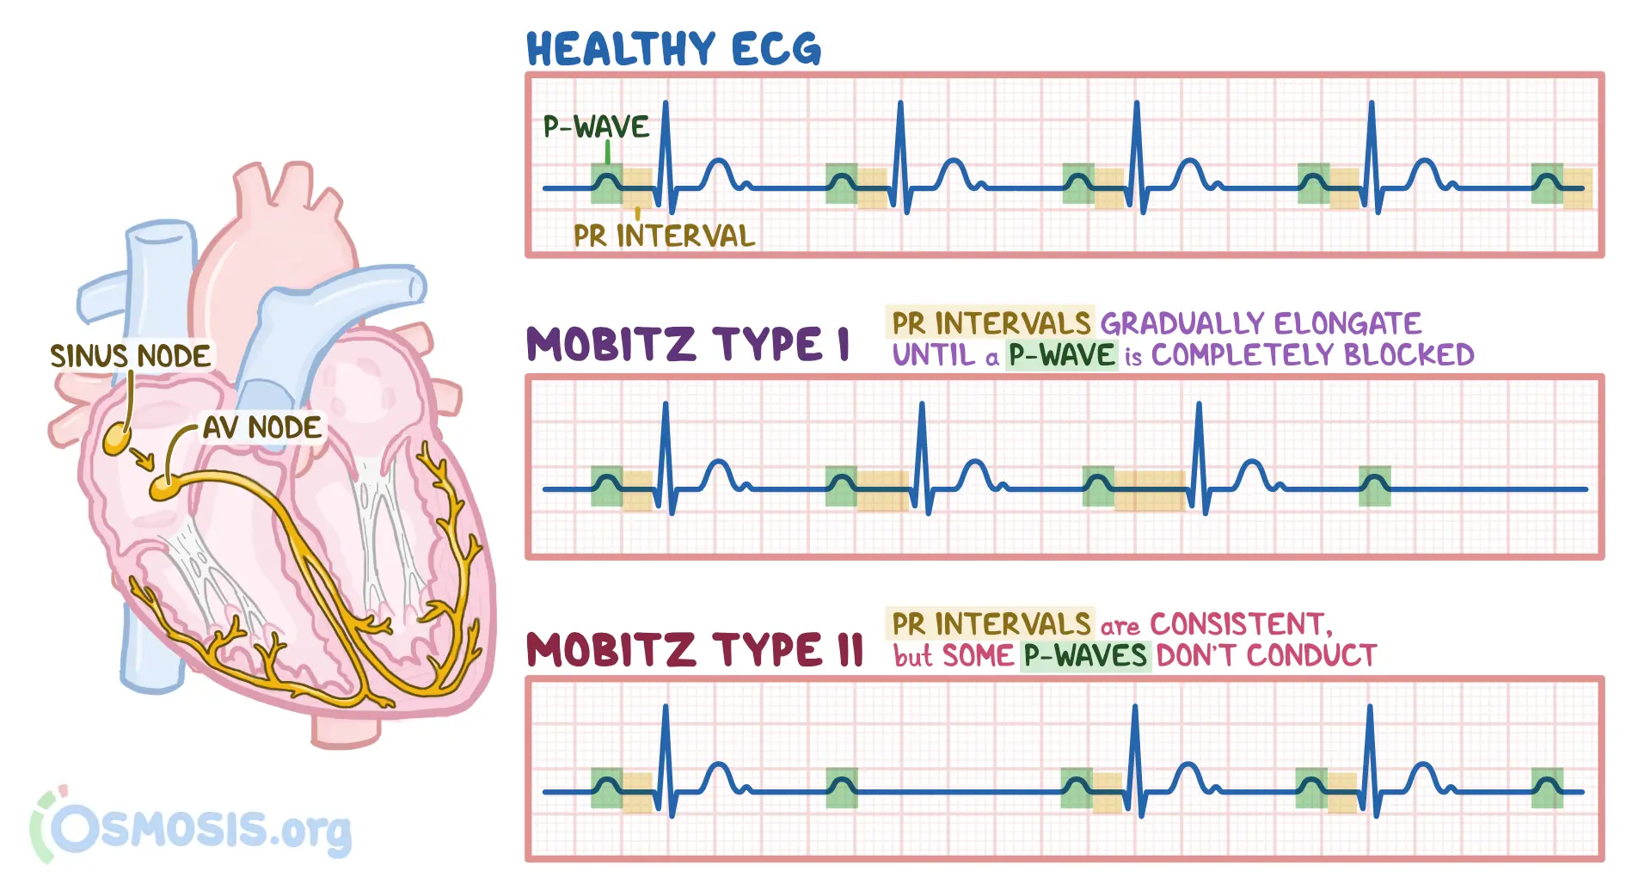
Notes:
Dropped Beat – P wave without a QRS complex

Slide 100
🫀 Second-degree HEART block
🔹Mobitz Type I (Wenckebach)
ECG pattern: Progressive prolongation of the PR interval until a P wave fails to conduct (a dropped QRS), then resets and the cycle repeats
Anatomical site: Typically within or just above the AV node—termed a supra‑Hisian block
Clinical significance: Often benign, seen in younger or highly vagal individuals; minimal risk of progression to complete block
Treatment: Usually none needed unless symptomatic
Notes:
highly vagal individuals = associated with a greater ability to recover from stress, as it promotes the activation of the PNS.

Slide 101
🫀 Second-degree HEART block
🔹Mobitz Type I (Wenckebach)
ECG pattern: Progressive prolongation of the PR interval until a P wave fails to conduct (a dropped QRS), then resets and the cycle repeats
Anatomical site: Typically within or just above the AV node—termed a supra‑Hisian block
Clinical significance: Often benign, seen in younger or highly vagal individuals; minimal risk of progression to complete block
Treatment: Usually none needed unless symptomatic
Notes:
highly vagal individuals = associated with a greater ability to recover from stress, as it promotes the activation of the PNS.

Slide 102
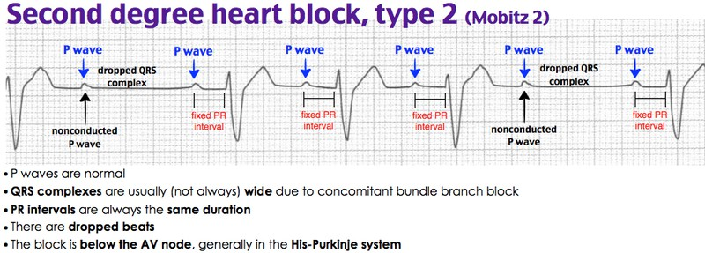

Slide 103
🫀 Second-degree HEART block
🔹 Mobitz Type II
ECG pattern: PR interval remains constant; however, occasionally a P wave fails to conduct unexpectedly (no progressive lengthening).
Anatomical site: Below the AV node—within the His‑Purkinje system (infra‑Hisian block)
Clinical significance: Often associated with structural cardiac disease; high risk of rapid progression to third‑degree AV block, syncope, or sudden arrest
Treatment: Permanent pacemaker is typically required, even if asymptomatic
Notes:
highly vagal individuals = associated with a greater ability to recover from stress, as it promotes the activation of the PNS.

Slide 104
🫀 symptoms & Clinical Significance
Symptoms: Palpitations, dizziness, shortness of breath, chest discomfort, fainting.
Severe risks: Stroke (especially in AFib), heart failure, sudden cardiac arrest (particularly with VF or Torsades).
🫀 Tools and tests:
ECG (often first line)
Holter or event monitors for prolonged assessment
Electrophysiology studies (in-depth electrical mapping)
Imaging and other tests (echocardiography, CT, MRI, tilt-table)
Notes:
highly vagal individuals = associated with a greater ability to recover from stress, as it promotes the activation of the PNS.

Slide 105
🫀 Treatment & Management
Lifestyle modifications: Avoid stimulants (caffeine, alcohol), manage sleep apnea, hypertension, etc.
Medications: Rate/rhythm control (e.g., beta‑blockers, calcium‑channel blockers, anticoagulants in AFib)
Procedures & Devices:
Cardioversion (electrical “reset”)
Catheter ablation for supraventricular arrhythmias and AFib
Pacemakers for bradycardia; ICDs for ventricular tachycardia/fibrillation
Notes:
Anticoagulants -

Slide 106
Thank YOU
And
Welcome to the academic year
2025 - 2026
Notes:
Anticoagulants -

